Slide 1


Slide 2
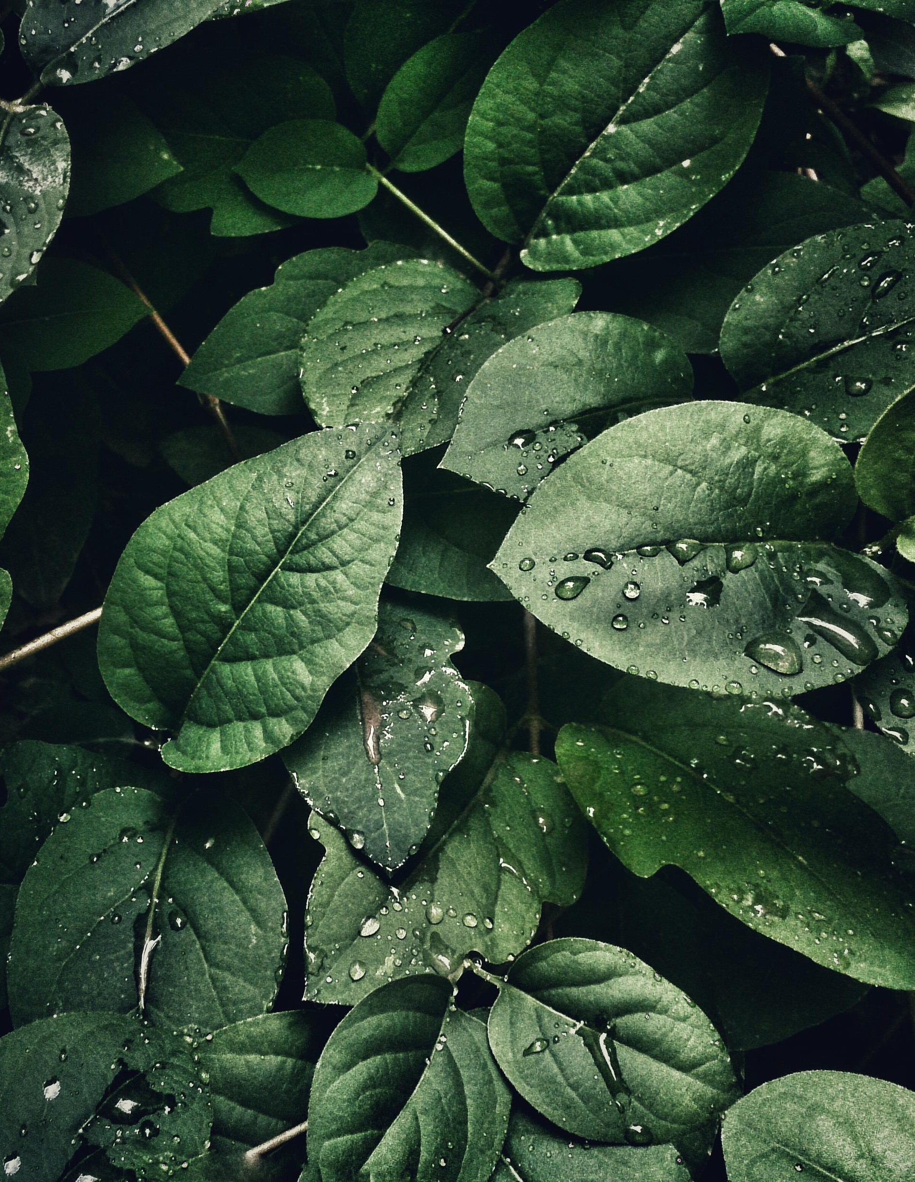

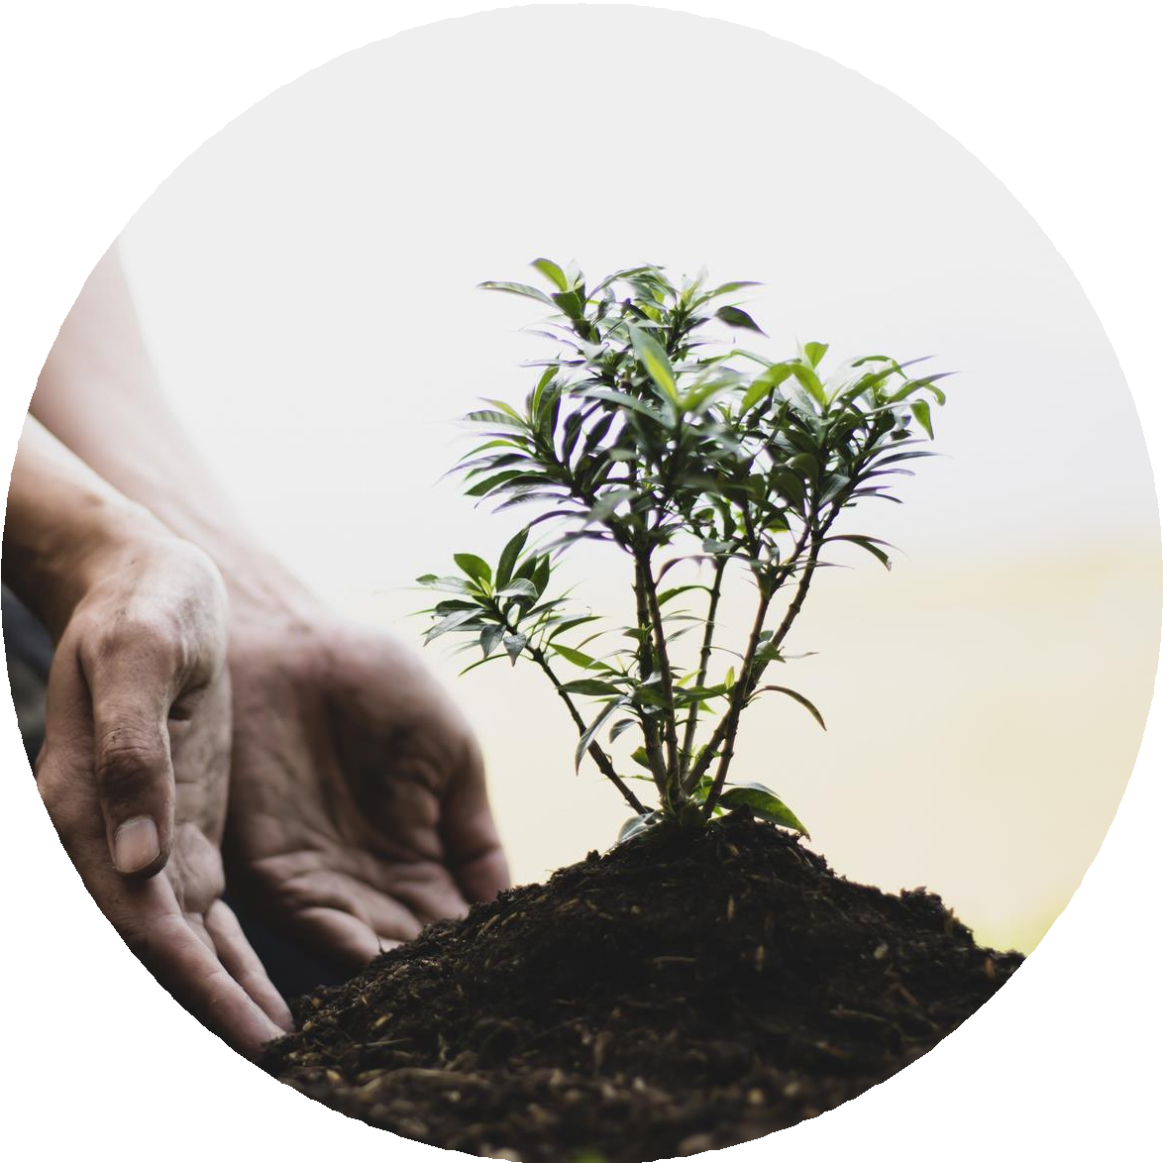
AI-Powered Plant Disease Detection System
Early Disease Identification s Treatment Suggestions for Nurseries , Urban Gardeners and Small-Scale Farmers.
Plankton

Slide 3
Introduction
Agriculture is the backbone of our economy, and plant health plays a crucial role in crop productivity.
However, plant diseases significantly reduce crop yield and quality. Early detection is very important, but manual identification requires expert knowledge.
Farmers often misidentify diseases, which leads to crop loss and improper pesticide usage.
To solve this problem, we developed PlantIQ — an AI-based plant disease detection system.

Slide 4


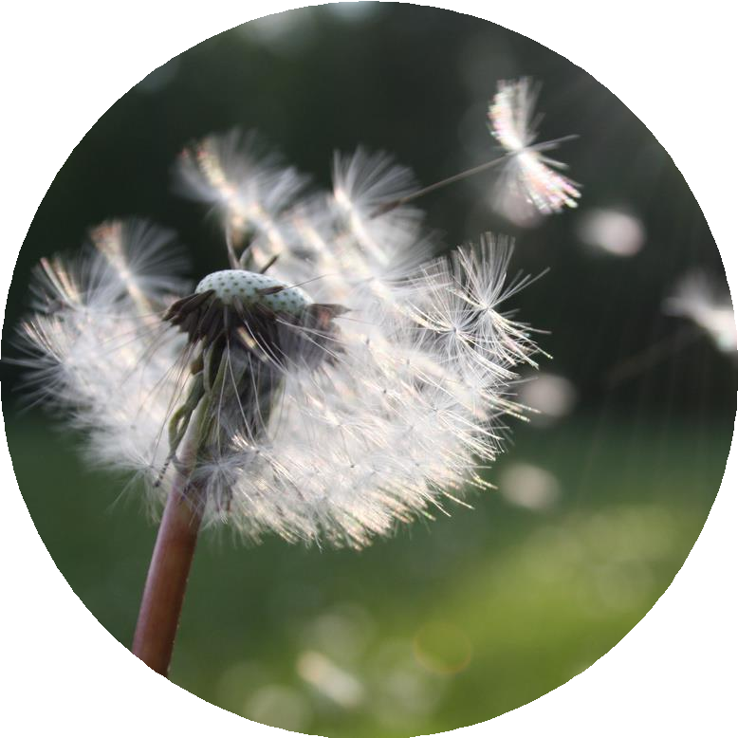
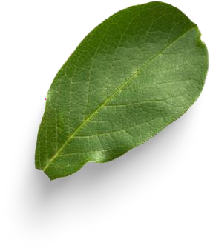
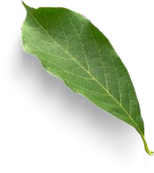
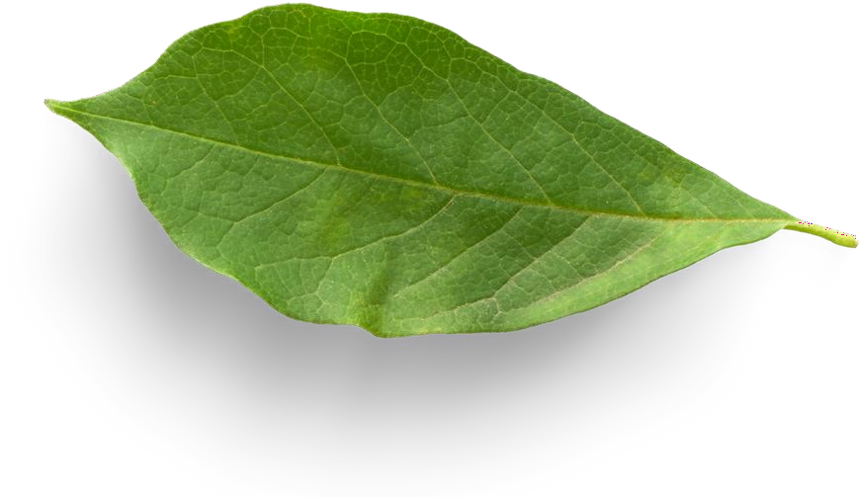
Nurseries & Urban Gardeners: Lack technical knowledge to diagnose and treat plant diseases.
Small-Scale Farmers: Struggle with early detection and effective treatment due to limited access to agronomists.
Limited Reliable Information: Online advice is scattered, often misleading, and not tailored to specific plant conditions.
Time-Sensitive Solutions Needed: Delayed diagnosis leads to crop losses and increased maintenance costs.

Slide 5
Existing System
Farmers rely on visual inspection
Consultation with agricultural experts
Lab testing methods
Manual methods are slow and costly
Not accessible to all farmers
Limitations
Time-consuming process Requires expert knowledge Expensive lab tests Prone to human error Not real-time detection

Slide 6

Step 1: User uploads a photo of an infected plant.
Step 2: AI model analyzes the image and detects disease.
Step 3: System provides treatment suggestions & care tips.
Step 4: Users can use our AI based chatbot to get their query solved.

Slide 7
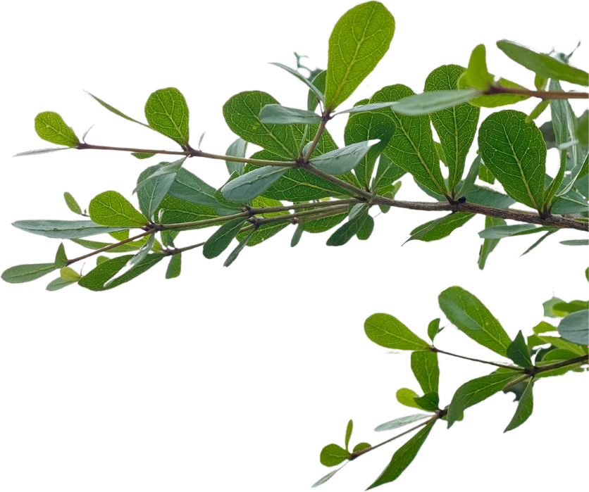
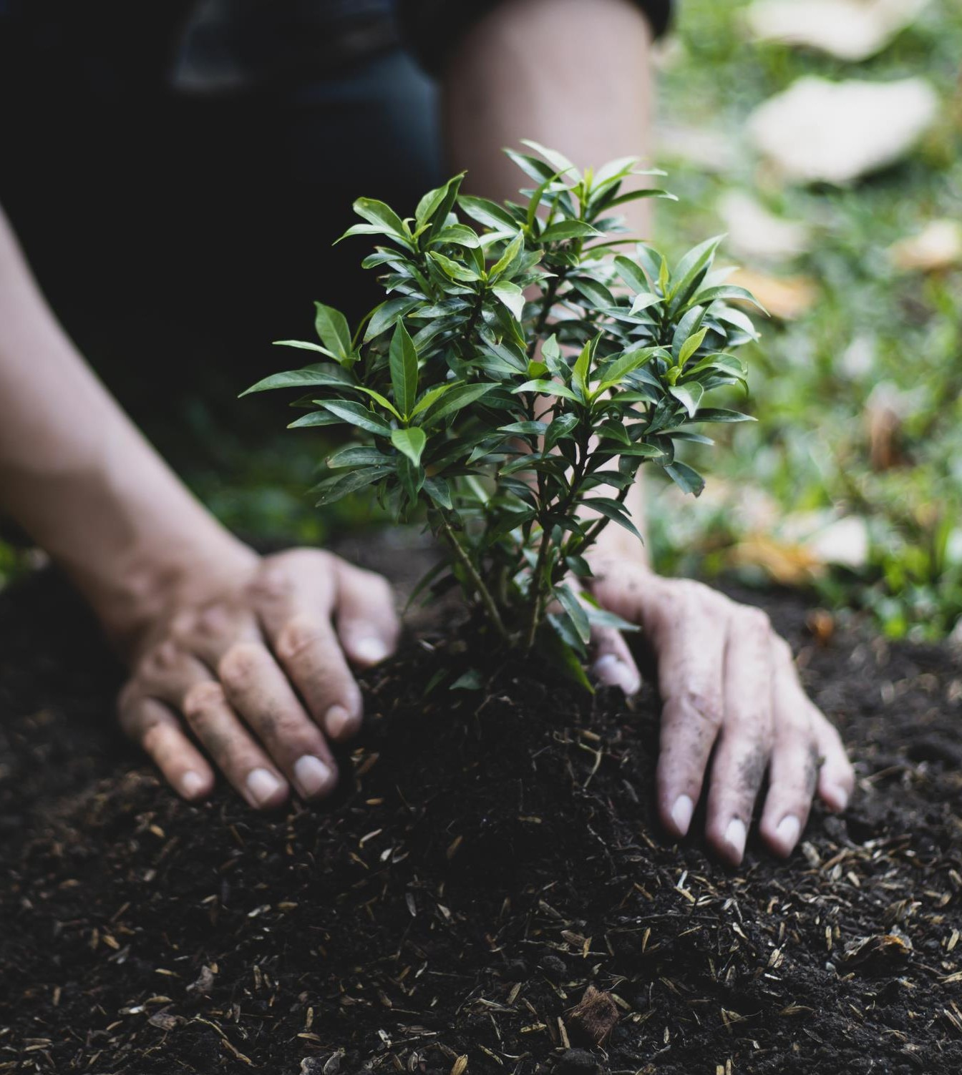





Instant disease detection through photos.
Accurate diagnosis of plant health problems.
Step-by-step treatment recommendations, including organic and chemical options.
Preventive care tips to prevent future issues.
Optional expert consultation for personalized advice.

Slide 8
Objectives
Detect plant diseases accurately
Provide early diagnosis
Reduce crop loss
Minimize pesticide misuse
Save time and cost

Slide 9
Proposed Methodology
Dataset Collection
Plant leaf images are collected from publicly available datasets such as PlantVillage. The dataset contains multiple plant species and disease categories, providing sufficient variability for model training and testing.
Data Preprocessing
Collected images undergo preprocessing to ensure uniformity and improve model performance. This includes resizing images to a fixed dimension, normalizing pixel values, removing noise, and applying data augmentation techniques such as rotation, flipping, and zooming.
Model Architecture Design
A Convolutional Neural Network (CNN) is designed for disease classification. The architecture consists of convolution layers for feature extraction, pooling layers for dimensionality reduction, and fully connected layers for classification.
Model Training
The preprocessed dataset is divided into training and testing sets.

Slide 10
Proposed methodology
Model Evaluation
Model performance is evaluated using accuracy and loss metrics
Backend Development
A Flask backend is developed to handle user requests, image uploads, and communication with the trained model. The backend processes input images and generates predictions
Frontend Development
A responsive web interface is designed using HTML, CSS, and JavaScript. Users can upload plant leaf images and view prediction results, confidence scores, and disease details.

Slide 11
Tools & Technologies
Programming / Backend
Python
Frontend
HTML CSS JavaScript
Framework—Flask (for web application)
AI / ML Libraries
TensorFlow / Keras
OpenCV
NumPy
Pandas
Model Type—Convolutional Neural Network (CNN)
Dataset—-Plant leaf disease dataset

Slide 12

Phase 1
Phase 2
Phase 3
Phase 4
Phase 5
Data Collection & Preprocessing
Model Development C Training
Chatbot Integration & Prototype Development
Testing & User Feedback
Final Deployment & Launch

Slide 13
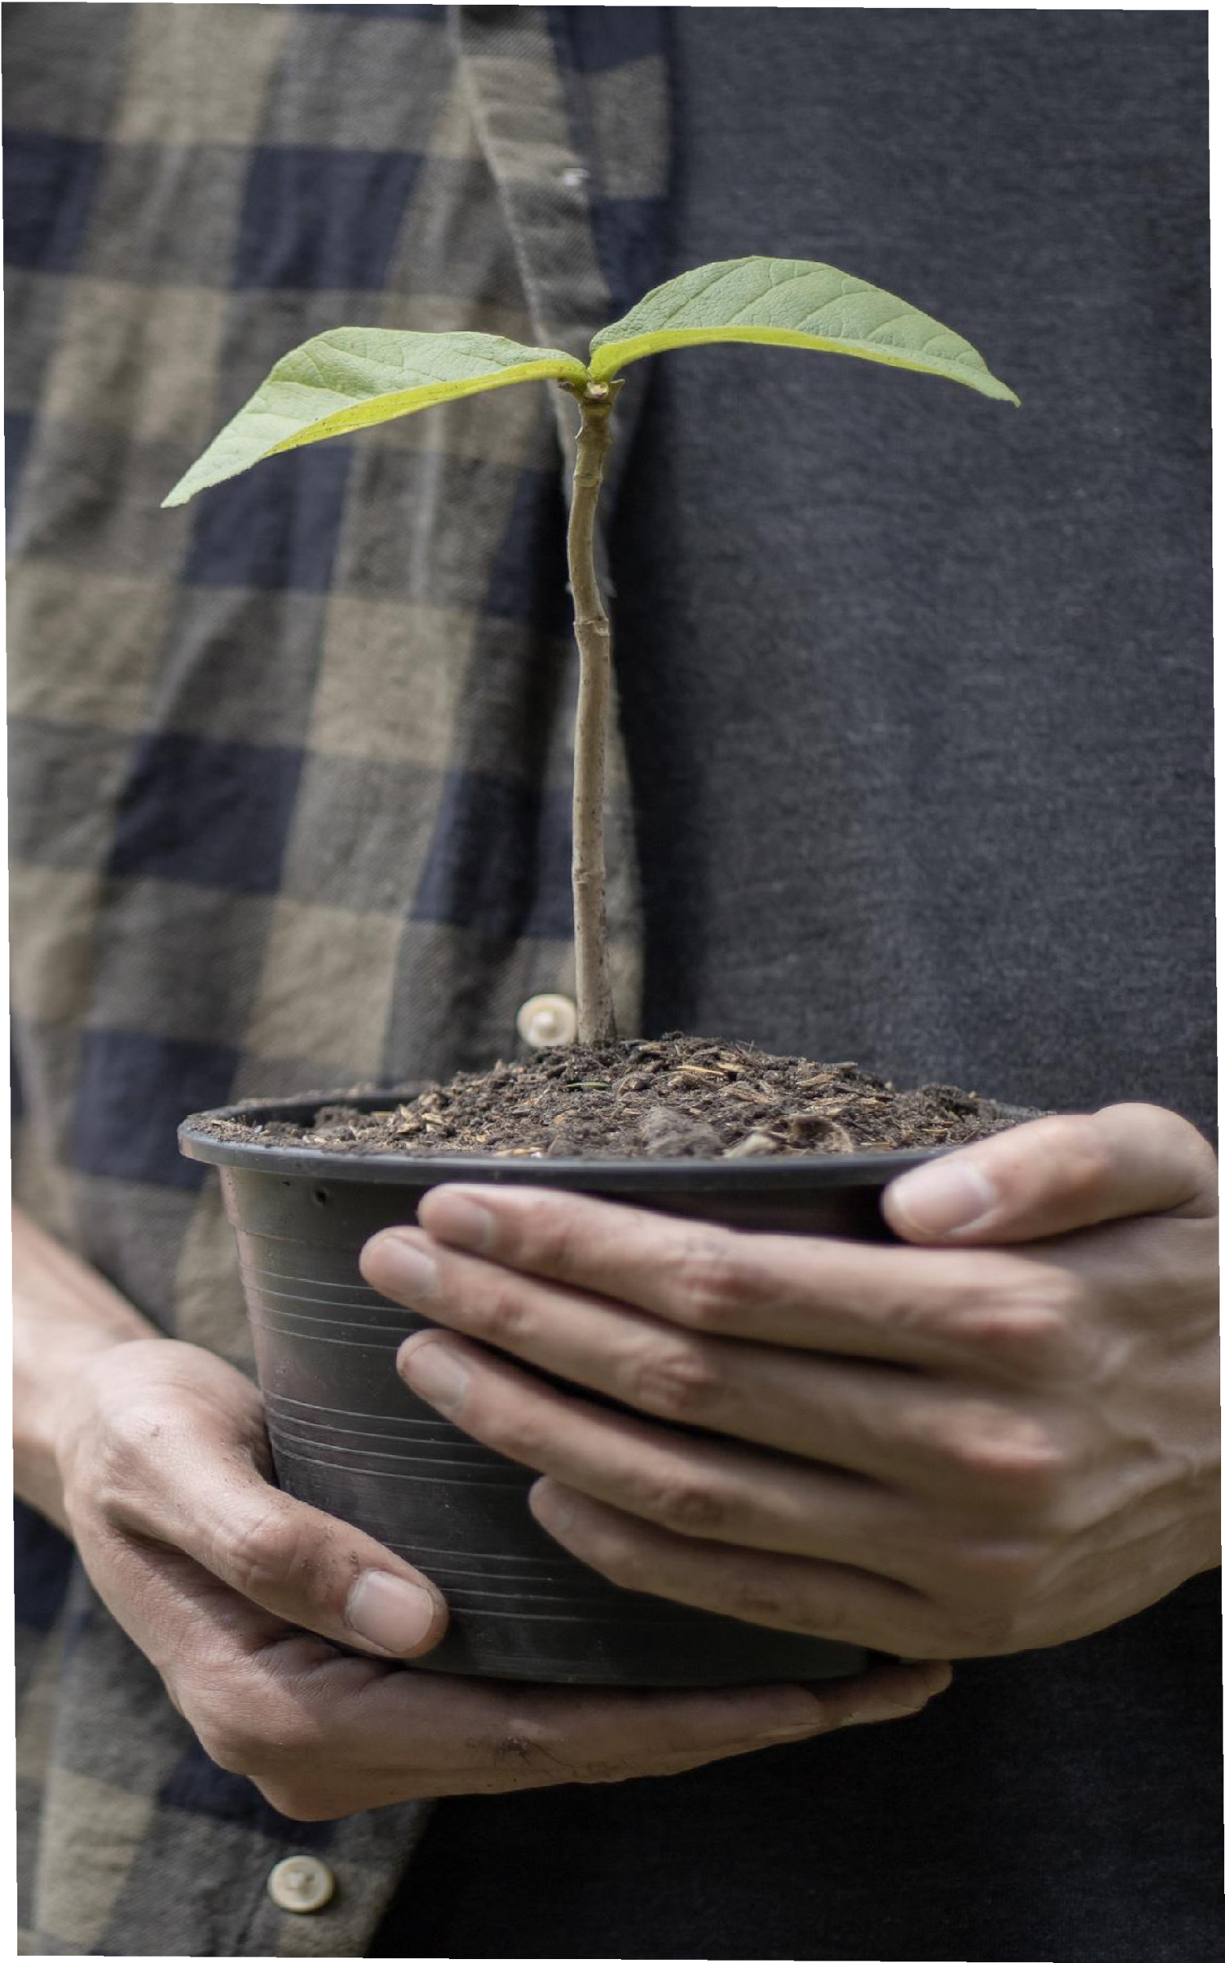



Primary Users (Phase 1):
Nursery Owners – Need fast disease detection to prevent inventory loss.
Urban Gardeners – Want to keep their home plants healthy.
Plant Enthusiasts & Hobbyists – Need expert care for rare/exotic plants.
Future Expansion:
Large-scale farmers C agricultural organizations.

Slide 14

